Slide 1
Targeted Advertising using Behavioural Data Mining
Prateek Chauhan Varun Yadav Samson Dias

Slide 2
Problem Statement
Due to high usage of internet and user information available on the internet, the behaviour of user can be determined using this data.
With the development of big data, cloud storage and data mining, targeting advertising technology has aroused wide attention.
With proper use of this data, user can be targeted with advertisement depending on their behaviour, demographic and sociographic traits.

Slide 3
Introduction
Targeted advertising is a form of advertising where online advertisers can use sophisticated methods to target the most receptive audiences with certain traits, based on the product or person the advertiser is promoting.
The Target advertising to a specific user based on the keywords on the page he or she is visiting.
Advertising campaigns are able to target the user is to use browser history and search history
This form of targeted advertising is centered around the activity/actions of users, and is more easily achieved on web pages .
Information from browsing websites can be collected from data mining, which finds patterns in users search history.

Slide 4
Type of Targeted Advertising
Search Engine Marketing
Retargeting
Behavioural targeting
Time based Targeting
Geographical and location based targeting
Social Media Targeting
Many more…..

Slide 5
How does it work
Depending on the search history , targeting system creates affinity between ads and user, then push the ranked ads to the user according to ad relevance.
But due to huge number of users, it is not scalable to adapt this type of ads delivery system.
In Behaviour Targeting system, users can be grouped based on their behaviour and similar behaviour denotes similar interest.
This enables advertisers to user segments closely related to their ad campaigns and gain higher profit by Targeted ads.

Slide 6
User Information
Mess Data Processing
Advertising Control System
User Grouping result
Relevant Ad

Slide 7
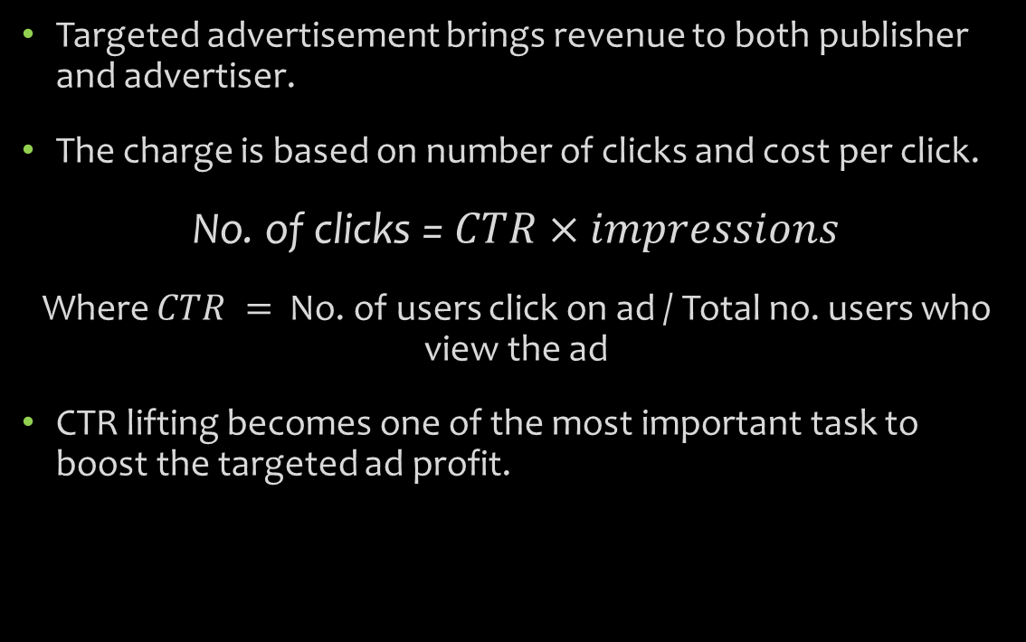
Revenue generator
Targeted advertisement brings revenue to both publisher and advertiser.
The charge is based on number of clicks and cost per click.
No. of clicks = $CTR×impressions$
Where $CTR =$ No. of users click on ad / Total no. users who view the ad
CTR lifting becomes one of the most important task to boost the targeted ad profit.

Slide 8
Literature Survey
“Search Behaviour Based Latent semantic user segmentation for advertising targeting.” 2013 IEEE paper based on user segmentation and targeted advertising.
This paper compares different clustering approaches that can be used to achieve best targeted advertising.
It proposes topic based user segmentation algorithm LDA (Latent Dirichlet Allocation) for CTR improvement.
Also referring,
“Design and Implementation of Targeting Advertising System” ICCSNT 2015 paper by Xuefie Wang and Yan Shi

Slide 9
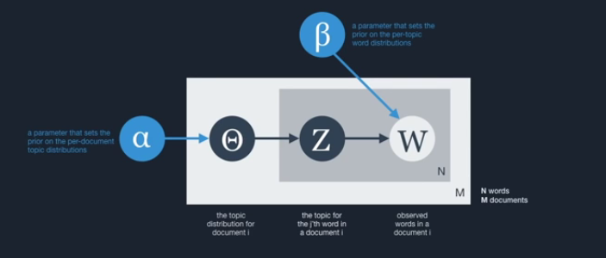
Approach
We are using LDA (Latent Dirichlet Allocation) to achieve the user segmentation .
LDA is a topic model that explains corpus of documents by unobserved groups of words.
LDA treats each topic as a distribution on words of vocabulary, and regards each document on those topic s.

Slide 10
Example
Suppose you have the following set of sentences
I eat fish and vegetables.
Fish are pets.
My kitten eats fish.
Latent Dirichlet allocation (LDA) is a technique that automatically discovers topics that these documents contain.
Given the above sentences, LDA might classify the bold words under the Topic F, which we might label as “food“. Similarly, underlined words might be classified under a separate Topic P, which we might label as “pets“. LDA defines each topic as a bag of words, and you have to label the topics as you deem fit.

Slide 11
Example
There are 2 benefits from LDA defining topics on a word-level:
1) We can infer the content spread of each sentence by a word count: Sentence 1: 100% Topic F Sentence 2: 100% Topic P Sentence 3: 33% Topic P and 67% Topic F
2) We can derive the proportions that each word constitutes in given topics. For example, Topic F might comprise words in the following proportions: 40% eat, 40% fish, 20% vegetables, …

Slide 12
LDA implementation
In our project instead of mining user profile or behavioural information to form user feature vector, we treat each user as an attribute of a query, clicked ad or <query, clicked ad>
Data set used
UserId: unique id for each user
QueryId: unique ID for each query
AdId: unique IDs for the ads
Click_or_not : 1 – ad is clicked 0 – otherwise
User segmentation is based on threshold:
Fixed Threshold: Apply to all user segments
User Distribution based dynamic threshold

Slide 13
Algorithm
Input:
η: percentage of initial user segment size;
S: set of user segments
Output:
Update user segments S;
Initialize removed user set RU;
For each s Є S do
Let k = η * |s|;
Sort s by probability in descending order;
Find kth largest probility p* in s;
For each u Є s do
If (pu<p*) then
Remove u from s;
Add u to RU;
End if
End for
End For
For each u Є RU do
If u does not belong to S then
Find s with max(pu);
Add u to s;
End if
End for
Return S;

Slide 14





Existing System

Slide 15
Main Objective
The Target advertising to a specific user based on the keywords on the page he or she is visiting.
To collect Information from browsing websites for data mining, which finds patterns in users search history.
To achieve high CTR value for ads, by using latent semantic user segmentation.
To increase ads relevance based on user search
Implement cloud storage system
To implement an auction system run by behavioural advertisement company for publishers and advertisers bid for the use of keywords.

Slide 16
thank you

